Slide 1
Dietary Interventions

Slide 2
Learning Objectives
Evaluate the effectiveness of decreasing energy intake or increasing energy expenditure with respect to weight loss.
Explain some of the factors that predict successful long term weight loss during an intensive lifestyle intervention.
Explain the long term trends in body weight between dieters and non-dieting adolescents.
Evaluate the difference between different macromolecules and food types as it relates to diets.
Consider the evidence from randomized controlled trials on low-carbohydrate versus low-fat diets.

Slide 3
General Principles of Weight Loss Diets
Mechanisms
Adherence
Reduced Energy Intake
Less Calories
Feelings of Fullness
Increased Energy Expenditure
Increased Thermogenesis – Dubious evidence
Alhassan S, Kim S, Bersamin A, King AC, Gardner CD. Dietary adherence and weight loss success among overweight women: Results from the A to Z weight loss study. Int J Obes. 2008; 32: 985–91. doi: 10.1038/ijo.2008.8.

Slide 4
Factors that Predict Successful Weight Loss
Support and Education
Initial Weight Loss Is Predictive of Sustained Weight Loss
Intensive Lifestyle Intervention
The Look AHEAD Research Group. Eight-year weight losses with an intensive lifestyle intervention: The look AHEAD study. Obesity. 2014; 22: 5–13. doi: 10.1002/oby.20662.
Notes:
DSE is diabetes support and education
ILI is intensive lifestyle intervention

Slide 5
Traits of Individuals with Sustained Weight Loss
No Effect of Gender, Effect of Ethnicity
Highest quartile of physical activity had a 9.4 fold greater chance of meeting weight loss goal compared to lowest quartile (lost 10% of weight)
Wadden TA, West DS, Neiberg RH, Wing RR, Ryan DH, Johnson KC, Foreyt JP, Hill JO, Trence DL, Vitolins MZ. One-year weight losses in the look AHEAD study: Factors associated with success. Obesity. 2009; 17: 713–22. doi: 10.1038/oby.2008.637.

Slide 6
Mediterranean Diet and Low Carbohydrate Diets
Foster GD, Wyatt HR, Hill JO, Makris AP, Rosenbaum DL, Brill C, Stein RI, Mohammed BS, Miller B, Rader DJ, Zemel B, Wadden TA, Tenhave T, et al. Weight and Metabolic Outcomes After 2 Years on a Low-Carbohydrate Versus Low-Fat DietA Randomized Trial. Ann Intern Med. 2010; 153: 147–57. doi: 10.7326/0003-4819-153-3-201008030-00005.

Slide 7
Common Diets and Fad Diets
On Friday we will discuss the evidence/mechanisms for some common diets
Low Carbohydrate/Ketogenic Diets
High Fiber
Intermittent Fasting
Portion Controlled Diets
Vegetarian/Vegan
If you have any other diets you would like to discuss let me know

Slide 8
The role of macronutrients in diets
Satiety
Protein is the most satiating
Energy Content
Lipids have high caloric content
Proteins and fiber are poorly metabolized
Macronutrient | Atwater Factor | Digestion Efficiency | Metabolizable
Lipids | 9 kcal/g | 86% | 7.8 kcal/g
Proteins | 4 kcal/g | 77% | 3.1 kcal/g
Carbohydrates | 4 kcal/g | 95% | 4.0 kcal/g
Fiber | 2 kcal/g | 61% | 1.2 kcal/g

Slide 9
Digestibility and Energy Extraction
Some foods are difficult to digest (proteins, fiber)
Some foods are easy to digest (sucrose, amino acids)
Cooking can increase the efficiency of digestion
See optional readings article “Eating Cooked Foods Made Us Human”
We do not have digestive enzymes for cellulose

Slide 10
The Effects of Refining on Energy Extraction
Refining removes
Micronutrients
Fiber
Makes the refined grain easier for digestive enzymes to access

Slide 11
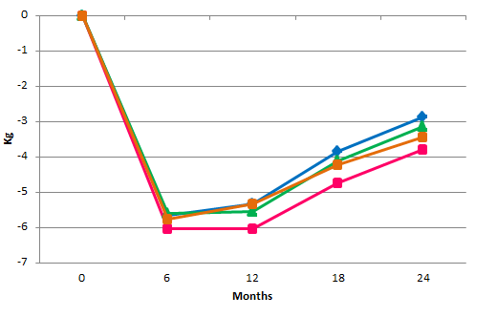

Does macromolecular composition matter?
Diet Composition
Calorie restriction is the key determinant of weight loss, not composition
Carbohydrate/
Protein/Fat (% energy)
Sacks FM, Bray GA, Carey VJ, Smith SR, Ryan DH, Anton SD, McManus K, Champagne CM, Bishop LM, Laranjo N, Leboff MS, Rood JC, de Jonge L, et al. Comparison of Weight-Loss Diets with Different Compositions of Fat, Protein, and Carbohydrates. N Engl J Med. 2009; 360: 859–73. doi: 10.1056/NEJMoa0804748.

Slide 12
General Considerations of Diet Effectiveness
How are calories reduced, or are they?
What are the changes of the individual staying on this program?
Is the diet associated with other lifestyle changes (i.e. increased physical activity)

Slide 13
Dieting and Weight Trajectory in Boys and Girls
Neumark-Sztainer D, Wall M, Guo J, Story M, Haines J, Eisenberg M. Obesity, disordered eating, and eating disorders in a longitudinal study of adolescents: How do dieters fare 5 years later? J Am Diet Assoc. 2006; 106: 559–68. doi: 10.1016/j.jada.2006.01.003.

